Slide 1


Project 8: Unsupervised ML
Edgar, Felicia, Mathieu
JUL, 4th | PARIS
DAFT MAY2022

Slide 2


Plan
Dataset
Challenges
Process

Slide 3
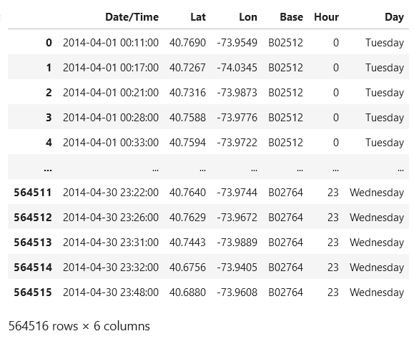
Dataset
Uber car location
Information about location, day, time
Exact coordinates

Slide 4
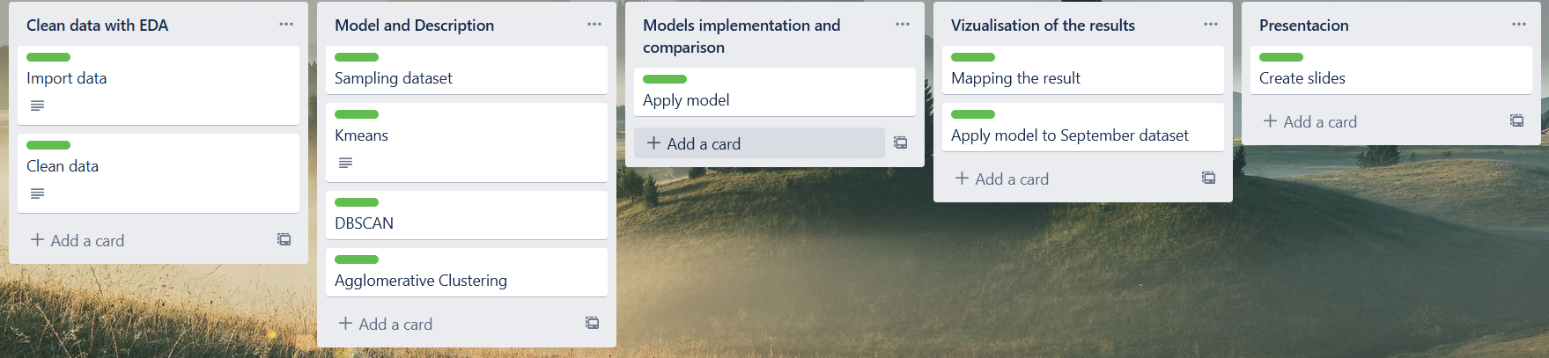
Challenges
Project planning with Kanban board
Data examination and cleaning
ML model creation
Visualization on a map

Slide 5
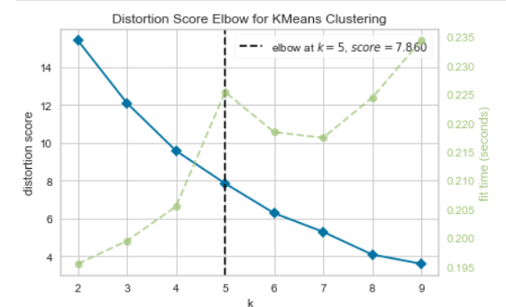
Process
Data exploration & cleaning
Sampling the dataset
Defining 3 model for ML
Mapping the result
Apply Model on September dataset

Slide 6
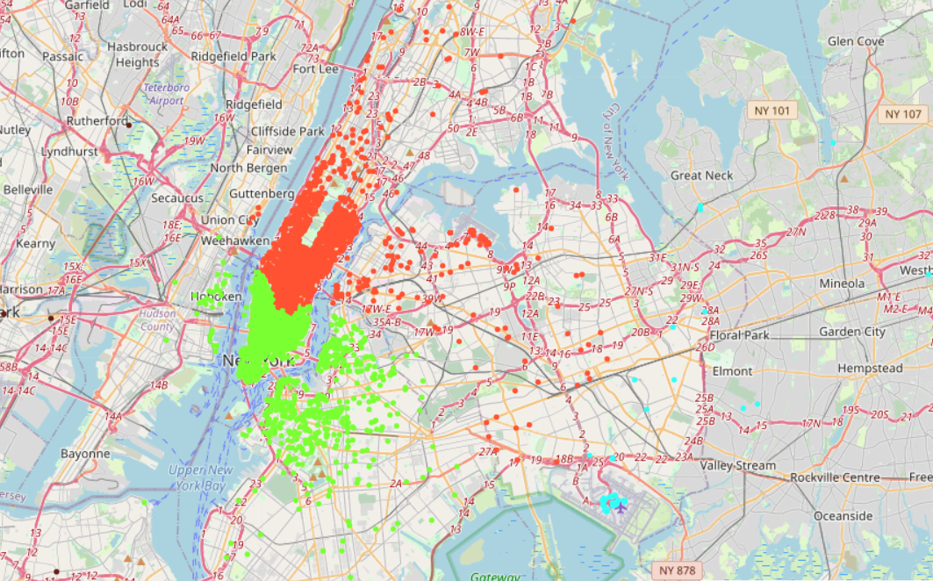
Demo

Slide 7
Project 8: Unsupervised ML
Edgar, Felicia, Mathieu
Questions?

